Slide 1

S.O.L.I.D.
Single Responsibility Principle

Slide 2

Definition
Introduced by Robert Martin (Uncle Bob) in Principal of Object Oriented Design
A class should:
have all of its services narrowly aligned
only ever have one reason to change

Slide 3

What does it mean?
The focus of a class should be narrowed
Methods should do just one thing
Methods should be reused
Things should be decoupled

Slide 4
Example
Duck
RunEverything() { Fly(); Swim(); Walk(); }

Slide 5
Example
Duck
Swim
Fly
Walk

Slide 6
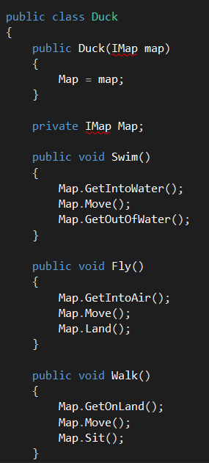
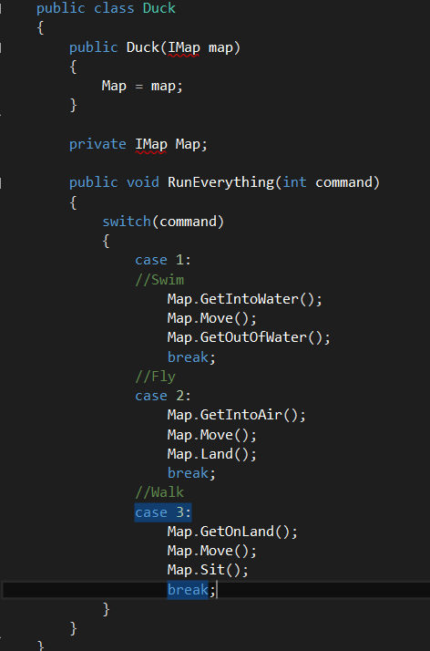
Example

Slide 7
Code Smells
Methods of greater than 5 lines
Conjunctions in names: And/Or
More than 3 words in a method
Lines of code in a class - you should never get lost
Multiple actors with multiple goals
Copy-paste programming

Slide 8
Kata – Mars Rover
New Instructions Here

Slide 9
Solution
New solution here

